Slide 1
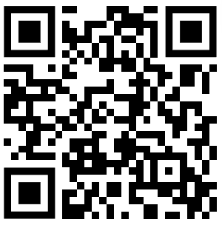


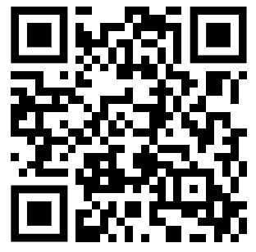



PRE SURVEY
Notes:
Welcome to GBM 1
Take notes bc lot of information
Name, Major
President for 2023-2024

Slide 2

HISTORY
Notes:
Go over history for those who are new

Slide 3
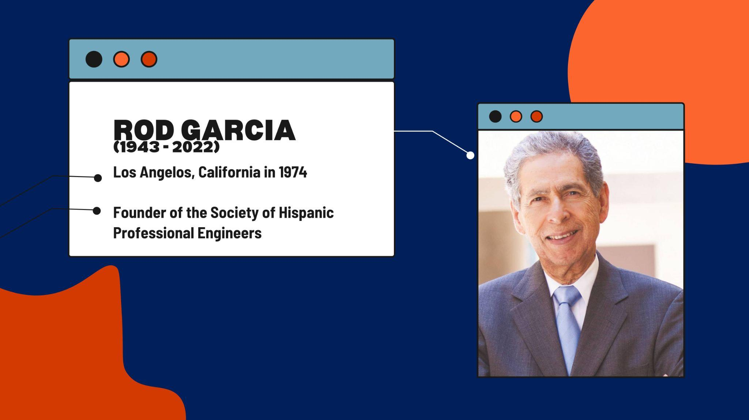
OUR FOUNDER
Notes:
Dominic

Slide 4
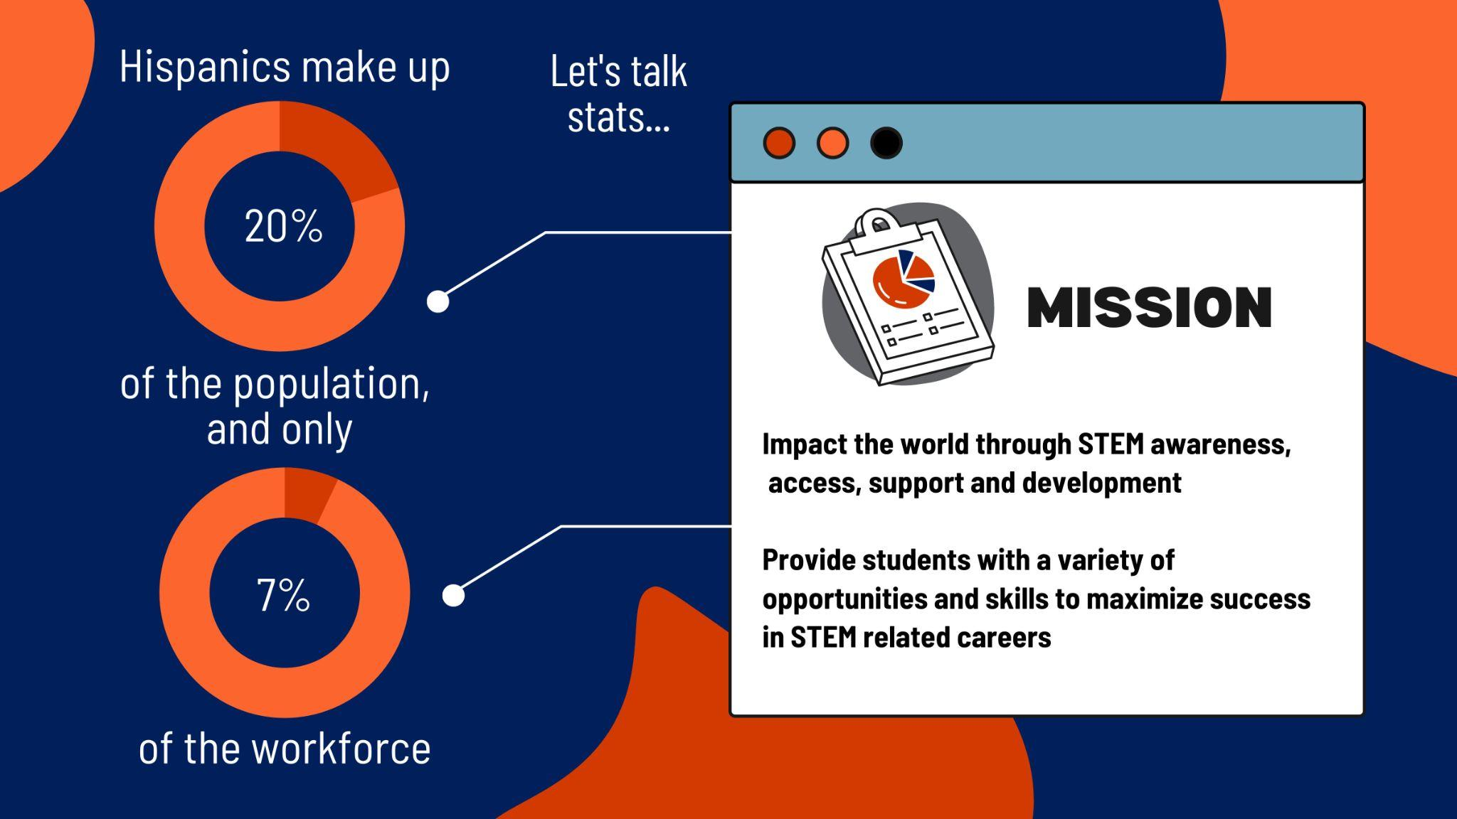
Notes:
Dominic

Slide 5

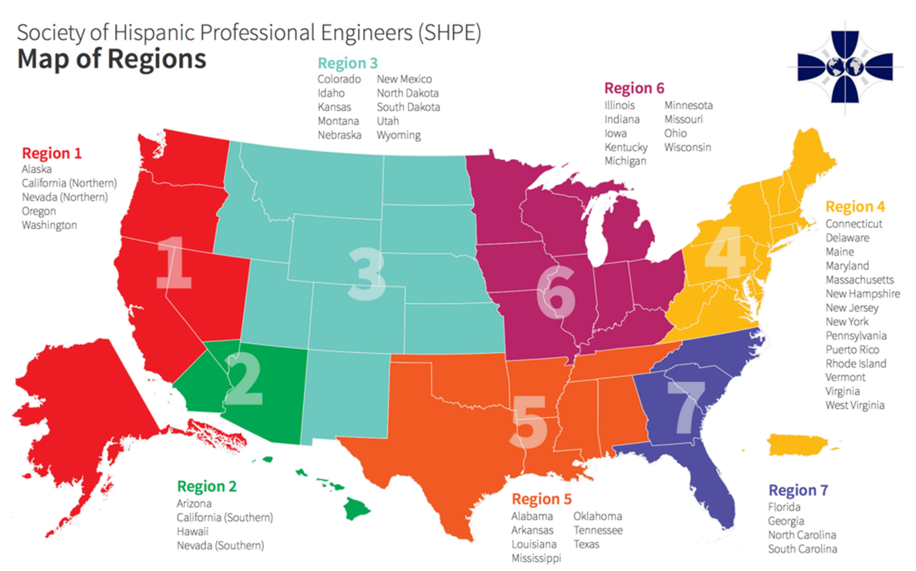
REGIONAL MAP
Region 7
Con la Región Siete. ¡Nadie se mete!
Notes:
Dominic

Slide 6

EVENT ANNOUNCEMENTS

Slide 7
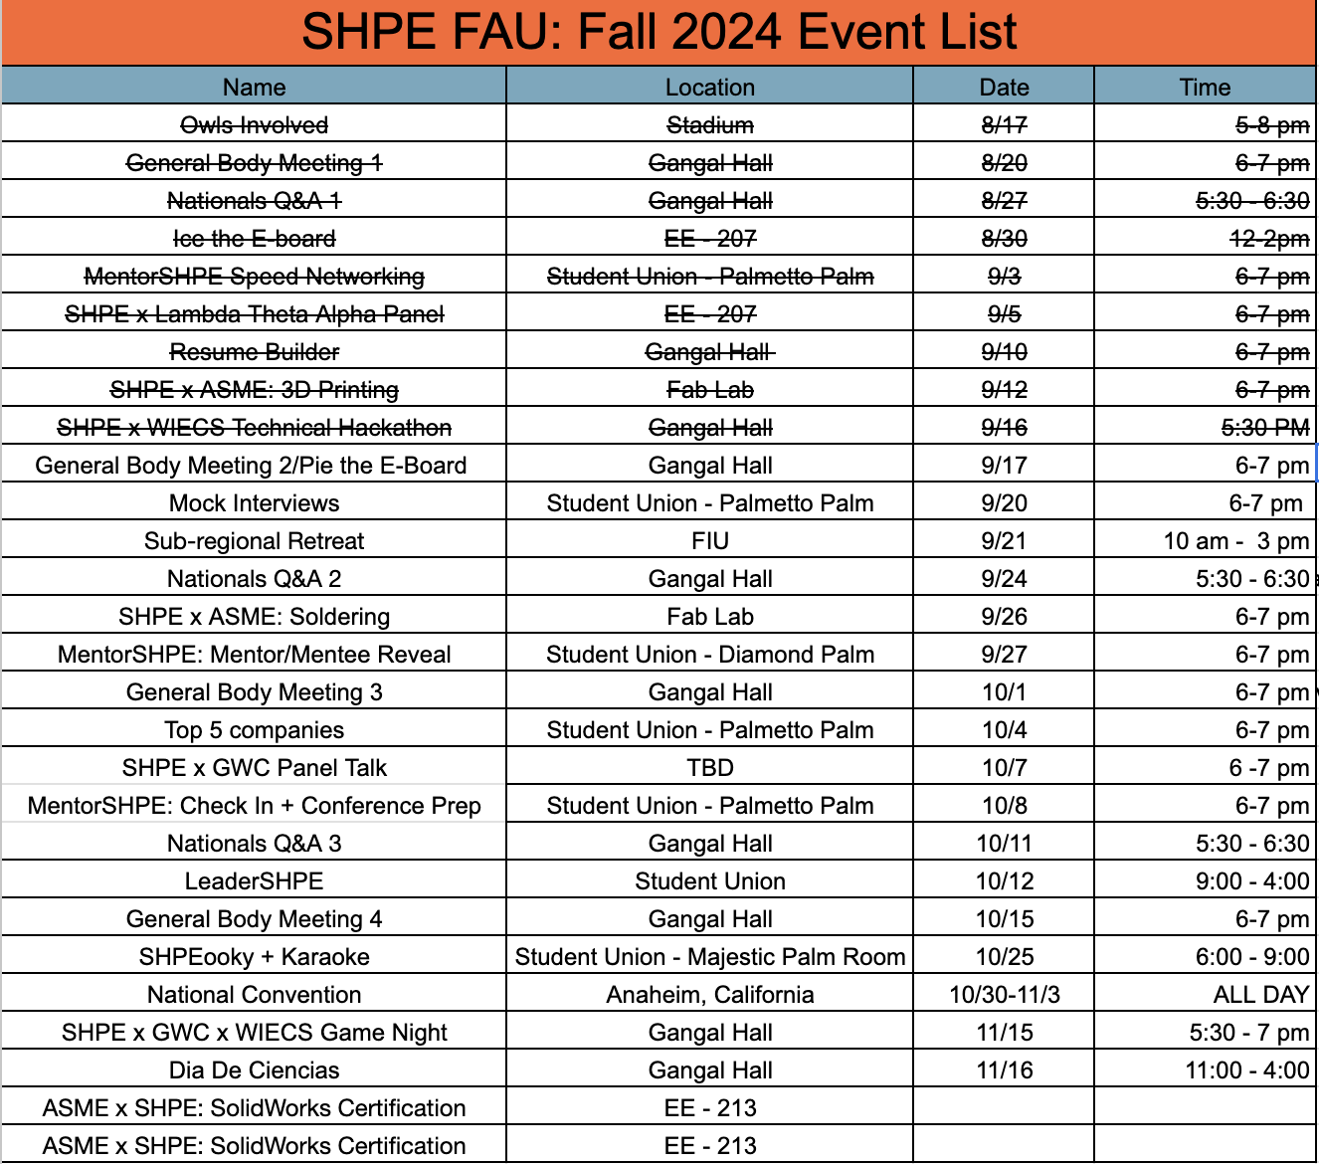

Slide 8


Mock Interview
September 20, 2024
6 - 7 pm
Student Union - Palmetto Palm
Come join us & sharpen your interview skills!
Conducted by students who have successfully navigated the hiring process at top companies.
You'll have the opportunity to experience real-world interview scenarios, receive valuable feedback, and learn key strategies for excelling in both behavioral interviews.
Notes:
TANIA

Slide 9
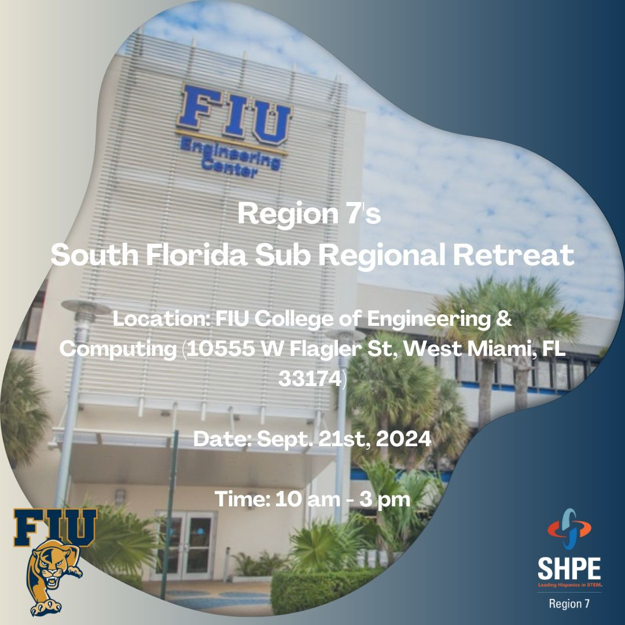
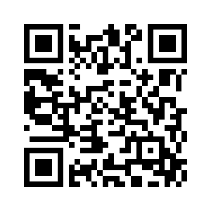
Sub Regional Retreat
September 21st, 2024
10:00 AM - 3:00 PM
FIU College of Engineering & Computing
(10555 W Flagler St, West Miami, FL 33174)
Tentative Schedule:
SHPE Convention 101 - Advice: 10:00 AM - 11:15 AM
Keynote by Alejandro: 11:30 AM - 12:30 PM
Resume Critique & Professional Coaching: 12:30 PM - 1:30 PM
Professional Panel + Q&A: 1:45 PM - 3:00 PM
Notes:
TANIA

Slide 10
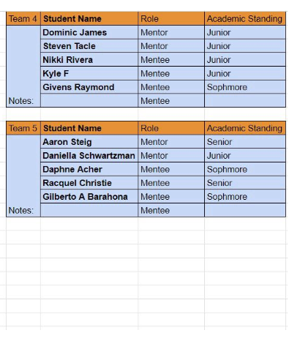
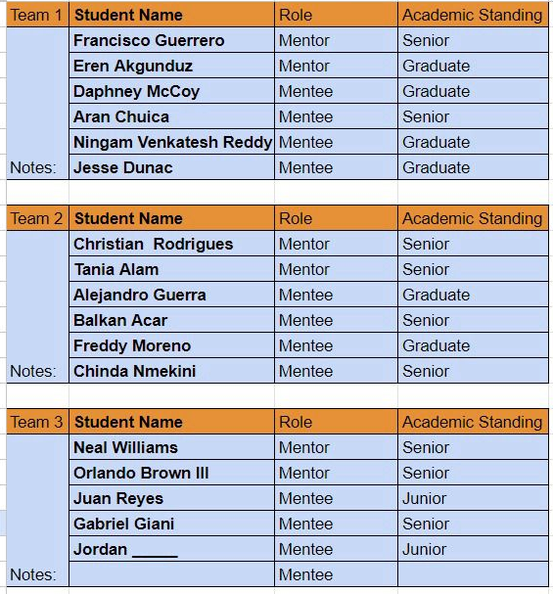

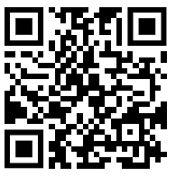
MENTORSHPE ANNOUNCEMENT
Join your team group chat!
Notes:
ELENA

Slide 11
Mentor/Mentee Reveal
September 25, 2024
6 - 7 pm
Location TBA
Join us for our Mentor/Mentee Reveal and Mixer! This will be your first opportunity to hang with your team all together. Get ready for a fun-filled evening of team-building activities, bonding, and a chance to connect with your MentorSHPE squad. Let’s break the ice and kick off this journey together!"
Join your team group chat!
Notes:
TANIA

Slide 12










LEADERSHPE
October 12, 2024 10:00am-4:00pm Engineering East: TBD
Mock Interviews Resume Critiques
Professional Closet Access
Networking
Presentations National Convention: Do’s and Don’t
Professional Guest Speaker
Professional Guest Speaker
Notes:
NEAL

Slide 13






SHPEooky & Karaoke
October 25, 2024
6 - 9 pm
Student Union - Live Oak
Come join us for a night of fun with karaoke and a costume contest.
Dust off your costumes and warm up your vocal cords for a spooktacular evening with SHPE! Join us for our "SHPEooky + Karaoke" night, where Halloween meets harmony in an unforgettable celebration. Whether you're coming to belt out your favorite tunes or just to cheer on your friends, it’s the perfect way to show your spirit—both Halloween and SHPE!
Notes:
TANIA

Slide 14
NATIONAL CONVENTION
Notes:
Ethan

Slide 15



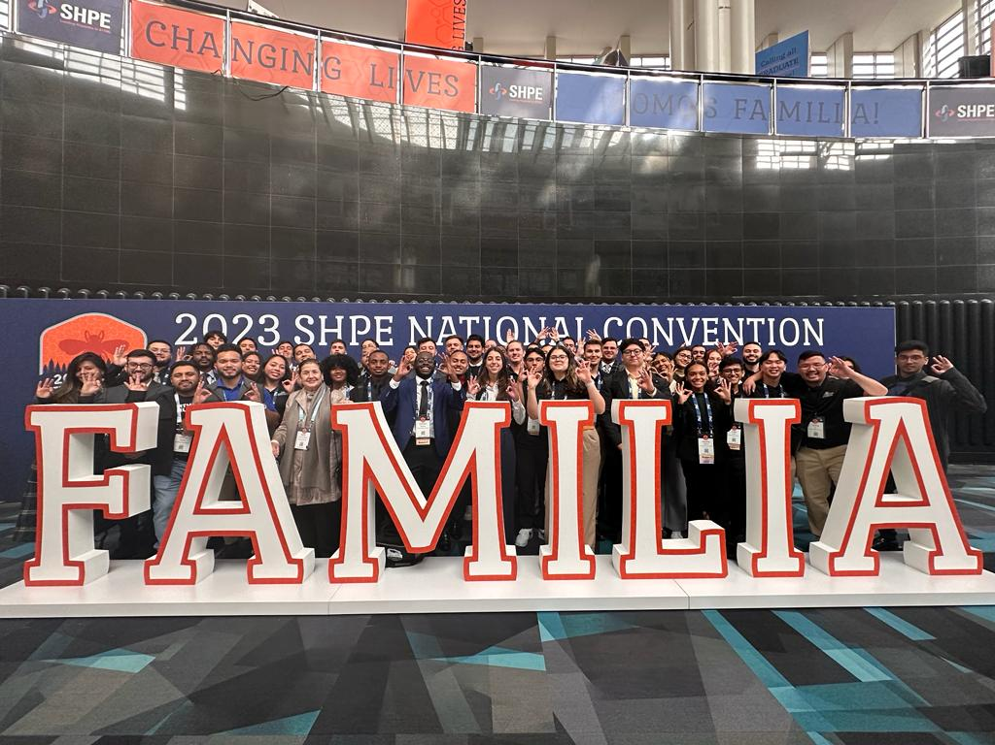
CONVENTION DETAILS
October 30th - November 3rd
Anaheim, California
Early Bird Prices (now - Sept. 15)
Members: $200
Non-Members: $499
Late Prices (Sept. 15 - onsite)
Members: $325
Non-Members: $599
Five Distinct Conferences: Pre-College, Academic, SHPEtinas, Professionals in STEM, and SHPETech
Notes:
Ethan

Slide 16




















CAREER FAIR & GRAD SCHOOL EXPO
Notes:
Ethan

Slide 17

CONVENTION BENEFITS
290+ sponsors and exhibitors hiring leading Hispanics in STEM
100+ onsite skill-building workshops
7 regional meetups and networking time
6 in-person, interactive networking events
5 signature events celebrating the Familia
5 challenging, fast-paced competitions
2 days at the onsite Career Fair & Graduate School Expo
4 days of onsite interviews with leading organizations
1 closing celebration party open to all attendees
Notes:
Ethan

Slide 18

NC Q&A SESSIONS
Still have questions regarding registration or national convention? Join us for our Q&A.
Still have questions? Join our Q&A Session
September 24th, 2024 Engineering East 5:30pm - 6:30pm Google Meets Link will be provided sooner to the date | October 11th, 2024 Engineering East 5:30pm - 6:30pm Google Meets Link will be provided sooner to the date
Notes:
Ethan

Slide 19


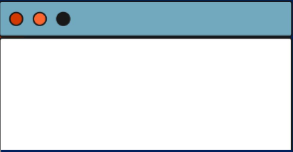
OWL CENTRAL
SHPE CONNECT
Go to SHPE on Owl Central
Click "Sign In" on the top- right corner, using your FAU Net ID and Password
Click “Join”
Click “Confirm”
Note: For exact steps, scan the QR code.
Undergraduate Membership: $10
Graduate Membership: $15
Login to existing account or create a new account on www.shpeconnect.org
Click on Join Membership.
Select Member Type ( Example: Undergraduate) , add selection to your shopping cart.
Select Region and Chapter Name (Region: 7, Chapter: Florida Atlantic University ), add to your cart.
Proceed to checkout to complete payment.
WHATSAPP + NEW MEMBER FORM
Notes:
Neal

Slide 20


FREE STOLES
Blue: Undergraduate Students
Black: Graduate Students
Requirements:
Must be enrolled on Owl Central
Must be enrolled on SHPE Connect for the 2024-2025 year
Attend all four General Body Meetings
Attend LeaderSHPE
Notes:
Tania

Slide 21

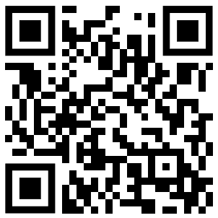
BINGO!
Get to know the e-board with bingo!
First one to complete it wins a prize
POST SURVEY
Notes:
Dom

